Slide 1
Getting Started with Mobile Development with Office 365

Slide 2
Getting started with Mobile development with Office 365

Slide 3
Agenda
Intro
Native development
Multi-platforms development

Slide 4
1
Intro

Slide 5
Developer vision

Slide 6
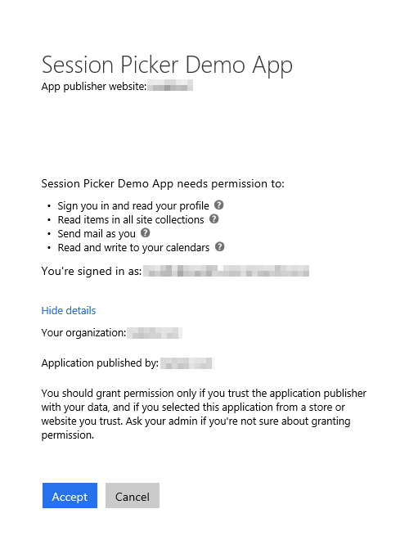
Azure AD OAuth in Office 365
Single authentication flow
  Across all Office 365 services
  “Native” apps and web sites
  Admin and end-user consent
Secure protocol
  OAuth 2.0 (no capturing user credentials)
  Fine-grained access scopes
  Supports MFA and federated user sign-in
  Long-term access through refresh tokens
Unique considerations
of “Native” Azure Apps
  Inherently multi-tenant
  No client/app secret (think about distribution)
  Leverage a web authentication window/broker (via ADAL)
  No application-only permissions (can go through proxy service)

Slide 7
Microsoft Graph Mobile SDKs
iOS
  https://github.com/microsoftgraph/msgraph-sdk-ios
Android
  https://github.com/microsoftgraph/msgraph-sdk-android
Cordova
  No SDK needed—Make REST API calls via Jquery
Xamarin/Windows Universal
  Use the .NET SDK

Slide 8

2
Native mobile apps

Slide 9
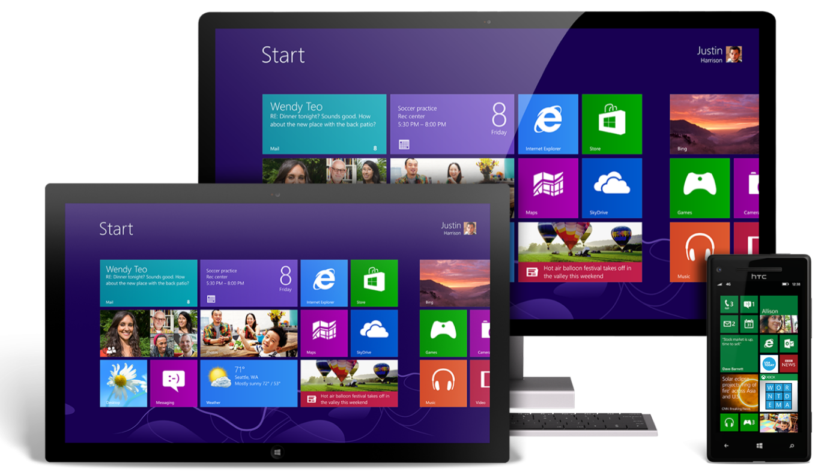
Universal Windows Apps
About
  Build application that runs across Windows Phones, tablets, and PCs
  Windows 10 realizes the convergence of Phone and PC
Development
  IDE: Visual Studio 2015 w/Windows SDK for Windows 10
  App registration: Add Connected Service Wizard
  SDK integration: Add Connected Service Wizard
When to use
  Target device footprint is exclusively Windows
  Application needs unique device-specific capabilities (ex: Cortana)
  Complex/Advanced user experience or visualizations
  Applications with strict enterprise requirements

Slide 10
Universal Windows Apps
Solution structure and debugging
  Windows 10 solutions are truly universal with a single project
  Template allow debugging against emulators or physical devices
Additional tips
  Must make UI responsive (vs. separate UIs in 8.1 Universal Apps)
  Take advantage of the best Windows 10 offers
  Consider ADAL vs. the new Web Account Manager

Slide 11
Universal Windows Platform
2 Native mobile apps
Demo
Notes:
Demo UWP with Web Account Manager: https://github.com/OfficeDev/MyFiles-API-Win10_UWP

Slide 12

Android
About
  Open source Microsoft Graph SDK for Android by Microsoft Open Tech (3/2014)
  Available on GitHub (http://bit.ly/1WhLZg4)
  Also requires ADAL for Android (http://bit.ly/1E7IfSi)
Development
  IDE: Android Studio (or Eclipse)
  App registration: Azure Management Portal
  SDK integration: build.gradle (similar to NuGet for dependencies)
When to use
  Target device footprint is exclusively Android
  Application needs unique device-specific capabilities
  Complex/Advanced user experience or visualizations

Slide 13
Android
Solution structure
  Form design (UI) is defined in .XML files (app\src\main\res\layout)
  Form logic is defined in .java files deriving from Activity
  Build.gradle references dependencies
  AndroidManiest.xml is the app configuration file
Debugging
  Debug apps with emulators (warning: SLOW) or Android device
  Consider Genymotion emulators that install separate from IDE
  Visual Studio 2015 Emulator
Additional tips
  Make sure you give the app permission to use the internet
  (in AndroidManifest.xml)
  Controls aren’t automatically referenced in form logic (must use findViewById)

Slide 14
Android
2 Native mobile apps
Demo
Notes:
If you have it, Demo Android Studio…else show:
ADAL for Android on GitHub: https://github.com/AzureAD/azure-activedirectory-library-for-android
Microsoft Office SDK for Android on GitHub: https://github.com/OfficeDev/Office-365-SDK-for-Android

Slide 15

iOS
About
  Open source Microsoft Graph SDK for iOS by Microsoft Open Tech (10/2014)
  Available on GitHub (http://bit.ly/1OMFlqk)
  Also requires ADAL for iOS (http://bit.ly/1u9Mexa)
  Apple does not permit compilation of iOS apps without Mac
Development
  IDE: Mac and XCode (Objective C or Swift)
  App registration: Azure Management Portal
  SDK integration: Cocoapods or manual build/copy
When to use
  Target device footprint is exclusively iOS
  Application needs unique device-specific capabilities
  Complex/Advanced user experience or visualizations

Slide 16
iOS
Solution structure
  Form design (UI) is defined in .storyboard files and logic is defined
  in view controllers
  References can be in the form of static libraries (.a) or frameworks (.framework), which include header files
  ADAL for iOS is a static library and the Microsoft Office SDK for iOS is a framework
Debugging
  XCode includes a really nice iOS emulator for debugging
  Registered Apple developers ($99) can debug on physical iOS devices
Additional tips
  Combine ADAL builds for emulator and physical device
  Use bridging header files for Objective-C references in Swift projects
  Println and Watch Expressions are really helpful tools for noobs

Slide 17
iOS and xcode
2 Native mobile apps
Demo
Notes:
Demo xcode and O365 native app if you have a MAC…else show:
ADAL for Android on GitHub: https://github.com/AzureAD/azure-activedirectory-library-for-objc
Microsoft Office SDK for Android on GitHub: https://github.com/OfficeDev/Office-365-SDK-for-iOS

Slide 18

3
Cross-platform mobile apps

Slide 19

Apache Cordova
About
  Platform for developing mobile apps with HTML, CSS, and JavaScript
  Open source collection of JavaScript that abstracts device-specific APIs
  All web assets are copied local to the device and run “Chromeless”
  Foundation for PhoneGap, AppBuilder, Ionic, etc.
Development
  IDE: >= Visual Studio 2013 w/Update 4 and VS Tools for Cordova CTP3*
  App registration: Add Connected Service Wizard
  SDK integration: Add Connected Service Wizard
When to use
  Multi-tenant apps or apps that target multiple mobile platforms
  Developers are skilled in web development (HTML, CSS, JavaScript)
  Licensing costs prohibit other cross-platform frameworks

Slide 20
Apache Cordova
Solution structure
  Office 365 assets installed under/services/Office 365
  Settings.js defines app details (client id, app redirect, etc.)
  o365Loader.js dynamically adds Microsoft Office SDK references to pages
Debugging
  Debug in Ripple (in-browser emulator), emulators, or physical devices
  Debug iOS w/remote Mac (can use emulator or remote/local device)
Additional tips
  Numerous Cordova plug-ins exist for rich device integration
  (custom with Git)
  Use NuGet to reference additional packages (Bootstrap, Angular, etc.)
  Cordova renders HTML… no native controls (w/o additional references)

Slide 21
Cordova
3 Cross-platform mobile apps
Demo
Notes:
Demo Cordova from Visual Studio 2015:
add connected service
Show scripts that get pulled in
Show settings.js that contains the app details
Show o365loader.js that bootstraps all the other scripts
Good completed app to demo: https://github.com/OfficeDev/Contacts-API-Mobile-App-with-Cordova-and-Ionic

Slide 22
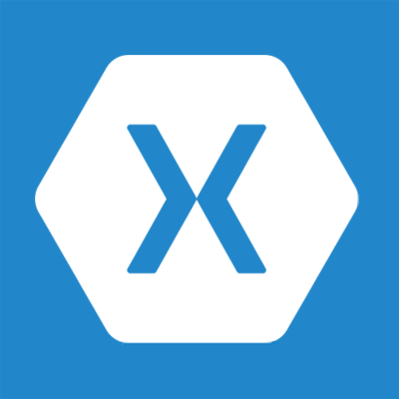
Xamarin
About
  Xamarin is a company (ISV) and development platform (licensed)
  Development based on .NET and complies to native platforms (Mono)
  Xamarin provides up-to-date versions of .NET for iOS and Android
Development
  IDE: Visual Studio 2015 with Xamarin
  App registration: Add Connected Service Wizard
  SDK integration: Add Connected Service Wizard
When to use
  Multi-tenant apps or apps that target multiple mobile platforms
  Development shop looking to leverage existing skills in C# and .NET
  Want cross-platform with a native UX feel (e.g., native controls)
  Want cross-platform with full access to device capabilities

Slide 23
Xamarin
Solution structure
  Xamarin project templates for device-specific platforms or shared
  Shared projects use shared portable libraries and device-specific projects (similar to Universal Windows Apps)
  Xamarin.Forms allows UI layouts to be shared but render native controls across Android, iOS, and Windows (can also use native layouts)
Debugging
  Debug Android/Windows with emulators or physical devices
  Debug iOS w/remote Mac and Xamarin.iOS (can use emulator or remote/local device)
Additional tips
  Xamarin binding project allow ADAL/SDK references
  ADAL v3 can help with binding challenges
  See: http://www.cloudidentity.com/blog/2015/07/22/USING-ADAL-3-X-WITH-XAMARIN-FORMS/

Slide 24
Xamarin
3 Cross-platform mobile apps
Demo
Notes:
Demo Xamrin project in Visual Studio…show forms options between native and Xamarin Forms
Add connected service

Slide 25
Mobile platform decision tree
Pic-a-Platform
Use Apache
Cordova
Yes
Budget
constrained?
No
Unique
device
capabilities?
Yes
Multi-device
support?
No
Windows?
No
.NET
shop?
No
Build native
No
Yes
Yes
Yes
Web
.NET or web
developers?
.NET
Use Xamarin
Build Universal Windows App
Use Xamarin

Slide 26
Summary
Intro
Native development
Multi-platforms development

Slide 27
Further reading…
Getting Started with APIs
Mobile dev Code Samples
Mobile dev Training videos
& hands on labs
Microsoft Graph API documentation

Slide 28
Developer Program launch
1 YEAR FREE
Email
Newsletters
Free Developer Subscription
Free
Training
Free
Tools
Webinars
http://dev.office.com/devprogram

Slide 29
Engage

